Slide 1
Classifying Activities of Daily Living from ambient and wearable sensor triggers using
Machine Learning methods
Coordinator: Alexandru Sorici (alexandru.sorici@upb.ro)

Slide 2
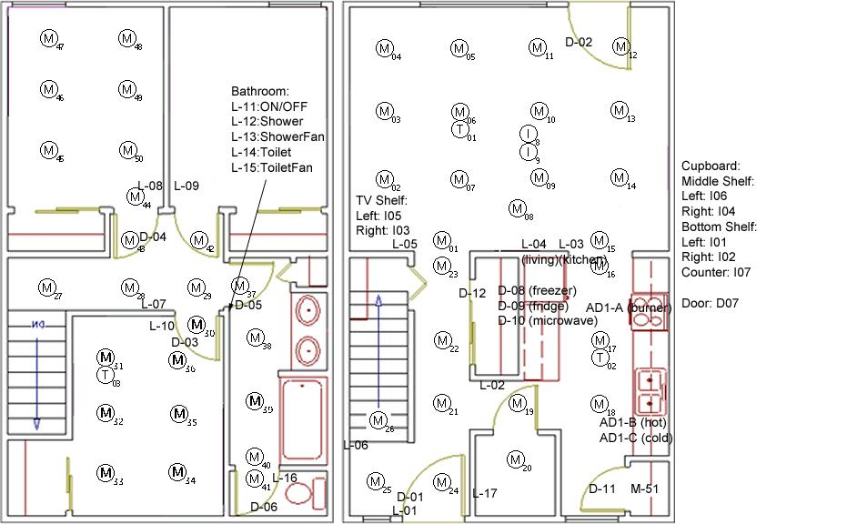
Objective: Apply ML methods to detect and classify single/multi user activities (sleep, use bathroom, prepare food, eat, entertainment) from binary and wearable sensor input
Defining and implementing change-point detection methods
Experiment with encoder-decoder and attention-based deep learning models to classify sequences of sensor activations into probable activities
Extend models for single-user activity detection to multi-user activity detection
Research subject continues existing work.

Slide 3
Context-aware search, discovery and querying of web-enabled sensors and actuators in
Ambient Intelligence applications
Coordinator: Alexandru Sorici (alexandru.sorici@upb.ro)

Slide 4
Objective: web-enabled service for context-aware search / discovery of sensors and actuators in smart environments
Define an explicit semantic representation for shared context, as well as for intended use of context information
Implement a scalable web-based service through which search, discovery and querying of context information are performed by respecting locality of context consumption rules
Integrate multi-agent specific concepts and organizational principles into the design of the intent-driven interactions
Research subject continues existing work.

