Slide 1
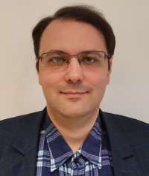
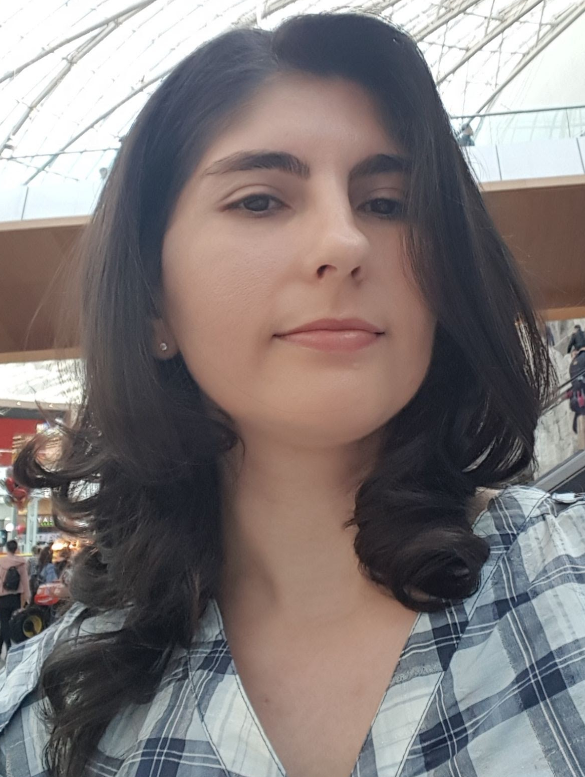
Machine Learning
Deep Learning
Big Data Analytics
Ș.L.Dr.Ing. Ciprian-Octavian Truică
ciprian.truica@upb.ro
Conf.Dr.Ing. Elena-Simona Apostol
elena.apostol@upb.ro
Text Analysis and
Opinion Mining
Data Management and
Data Mining
Time Series Analysis
Internet of Things

Slide 2
Research Topics
Network-aware fake news mitigation on social media
Context and network-aware fake news detection and mitigation
Text simplification
Gravitational-wave detection
Domain-specific multi-word extraction and abbreviation disambiguation for e-Health
Anomaly detection for Time Series
Change Point Detection for Time Series
Scalable Graph Mining Algorithms for Social Media Analysis

